Slide 1

Stats 2
ANOVA and Linear Models.

Slide 2
Analysis of Variance
Analysis of variance or ANOVA is actually very similar to what a t test does.
Most of these statistical tests compare group means and their associated data like variance, to show there is a difference between groups.

Slide 3
Analysis of Variance
The major difference is that this performs one test rather than many between all the combinations.
This helps to avoid false positives from multiple tests.

Slide 4
Type I and Type II errors
There are two types of error in statistics:
Type I
Type II

Slide 5
Type I and Type II errors
Type I is a false positive, or “the incorrect rejecting of a true null hypothesis”
When you believe something is happening but it really isn’t.

Slide 6
Type I and Type II errors
Type II errors are the opposite:
When you believe nothing is happening when it is.

Slide 7
Type I and Type II errors
Type I errors can occur when we do multiple tests as this is what our significance level based on.
When we are looking for a p value of less than 0.05 all we are saying is that we want there to be less than a 5% chance of it being a false positive.

Slide 8
Type I and Type II errors
If we do multiple tests on the same data based on a 5% chance of a false positive by the time we have done 10 tests there is a 50% chance a false positive has occured.
So to get around this it is generally best to do one big test.
This is where ANOVA comes in.

Slide 9
Analysis of variance
The ANOVA is the basis of linear models, which effectively do the same thing but add a bit more complexity.
ANOVAs are used to compare group means, it can be thought of as a series of T-tests on all the groups however it does it a slightly different way that avoids type I errors.

Slide 10
Analysis of variance
First of all the ANOVA has some assumptions we should cover first. These are generally true for all models (with some changes to make it so)

Slide 11
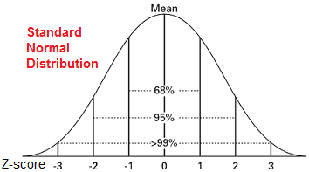
Analysis of variance
The first assumption is that data is normally distributed.
This means that most of the data is clustered around the mean with tails on either side.

Slide 12
Analysis of variance
The second assumption of ANOVA is the independence of variables, this is a tricky one to confirm but essentially is that the variables of the two groups are not dependent on the other.

Slide 13
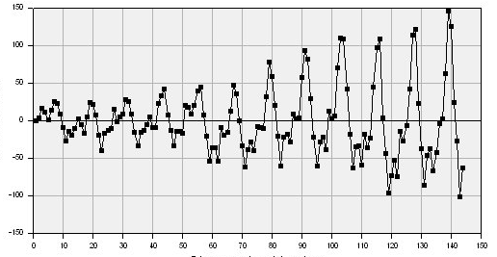
Analysis of variance
The third assumption is that the variance of the data is constant.
This essentially is that the difference between the data and the mean of the data does not form a variable pattern. i.e get further from the mean the higher the values etc.

Slide 14
Analysis of variance
The fourth and final assumption is that the residuals of the model have a mean of 0 at all points.
What this assumption is basically saying is that the error distribution is also normal, not changing with the data.

Slide 15
Analysis of variance
ANOVA and linear models are built upon sums of square differences.
The sums of squares is essentially the square of the datapoint compared to the mean.
Pretty much the same as variance we worked out in standard deviation.

Slide 16
Analysis of variance
ANOVA and linear models are built upon sums of square differences.
You compare the sum of square means or mean squares between groups to see if they are statistically significant.
This time instead of a t test with a t statistic it is an F test.
This compares the sum of squares of groups rather than just the mean.

Slide 17
Analysis of variance
ANOVA and linear models are built upon sums of square differences.
You compare the sum of square means or mean squares between groups to see if they are statistically significant.
This time instead of a t test with a t statistic it is an F test.
This compares the sum of squares of groups rather than just the mean.

Slide 18
Analysis of variance
The F test statistic takes into account the degrees of freedom of the model.
Degrees of freedom are a tricky concept to get your head around.
It is essentially the dimensions in which you can let the data vary to get to another point.
Often it is simply n-1 or n – number means you are testing.

Slide 19
Linear Models
Linear Models are based on ANOVA, they do very similar things.
An ANOVA tests the group means of data and compares them, a linear model fits the data to a straight line to see if there is a relationship between them.
They both still work on the differences of sum of squares to a mean.

Slide 20
Linear Models
In R there is very little practical difference other than an anova is on factors while an lm works of continuous data and factors.

Slide 21
Comparing models
What happens if we want to see if two different explanatory variables have an effect on the same thing?
What if when we run the model only one is significant?

Slide 22
Comparing models
What happens if we want to see if two different explanatory variables have an effect on the same thing?
We can run linear models on multiple explanatory variables but we need to make sure we are aware of how many degrees of freedom we are using.
The more explanatory variables we use the more degrees of freedom that are taken up, leading to a fitted model.

Slide 23
Comparing models
What if when we run the model only one is significant?
Well we want to compare models to see which is better.
We compare models using likelihood.

Slide 24
Comparing models
Likelihood is an incredibly simple concept with an incredibly complicated science behind it.
Likelihood vs probability is the basis of Bayesian statistics which we don’t have time to cover.
In this case we are asking based on our results what is the likelihood of our model predicting correctly.

Slide 25
Comparing models
Likelihood of a model is generally used as a score to see how well your model fits the data.
We can then use this to compare two different models and see which is better
However….

Slide 26
Comparing models
If we think about degrees of freedom…
Degrees of freedom are essentially the data points in your data.
You fit a model that varies around those data points by attaching the model parameters to a data point and varying the rest.

Slide 27
Comparing models
You fit a model that varies around those data points by attaching the model parameters to a data point and varying the rest.
If you fit a parameter per data point your model will fit exactly to those parameters and be completely likely.
This makes likelihood not the best measure

Slide 28
Comparing models
Instead of Likelyhood we use AIC.
AIC is basically likelihood corrected for the number of parameters in the model.
It is the primary way of comparing models.

